Slide 1

Fake AD Click Detection
Gautam Shanbhag (18210455)
Supervisor : Prof. Mark Roantree
Dublin City University
Notes:
Brief introduction of the Domain and its working
Its impacts and its importance

Slide 2

Introduction to AD World
Pay-per-click (PPC), is an internet advertising model used to drive traffic to websites, in which an advertiser pays a publisher (typically a search engine, website owner, or a network of websites) when the ad is clicked.
https://charlesngo.com/beginners-guide-native-advertising-for-affiliate-marketing/
Notes:
Familiar with basic of Digital Advertising world
Mobile app ads, search engine ads, ads on social media etc
Advertising model works on concept of pay per click
Advertisers pays publisher a certain amount to divert traffic from its site/app to a specific target site/app
Problems that Ad World Face

Slide 3
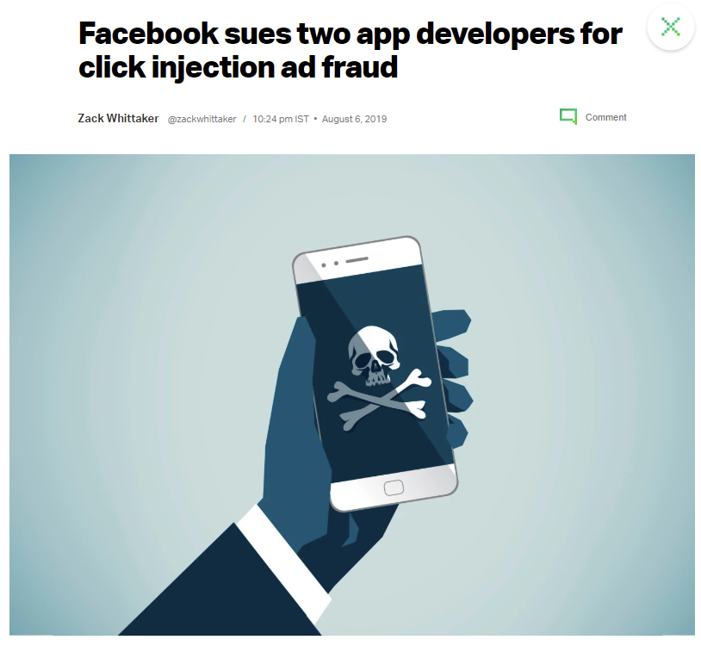
Problems of AD World
https://techcrunch.com/2019/08/06/facebook-clickjacking-ad-fraud-suit/
Notes:
Generating Fraudulent Revenue using their ad platform

Slide 4
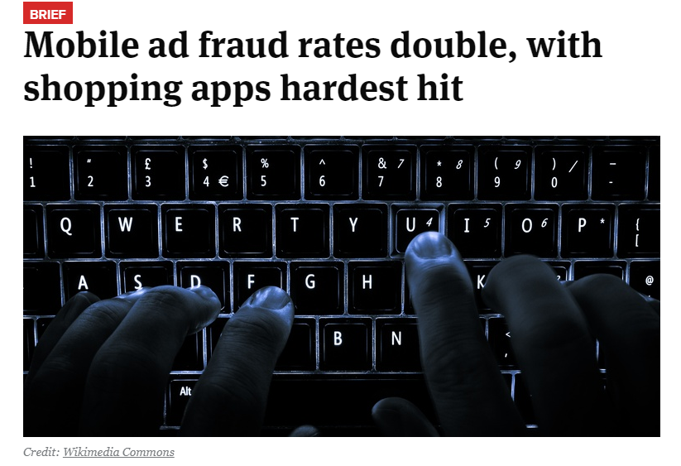
Problems of AD World
https://www.retaildive.com/news/mobile-ad-fraud-rates-double-with-shopping-apps-hardest-hit/523240/
Notes:
Mobile Ad Fraud doubled in 2018 as compared to 2017 with estimate loss of $4.9 billion dollars
Ecommerce website faced the biggest losses due to 40% of clicks rejected
Followed by game app industry
Adverters lost around 80% of their total ad budget to click fraud

Slide 5
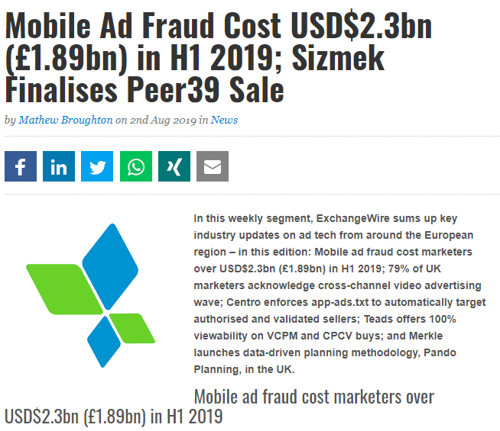
Problems of AD World
https://www.exchangewire.com/blog/2019/08/02/mobile-ad-fraud-cost-usd2-3bn-1-89bn-in-h1-2019-sizmek-finalises-peer39-sale/
Notes:
Mobile Ad Fraud costed 2.3$ billion US dollars in first quarter of 2019

Slide 6
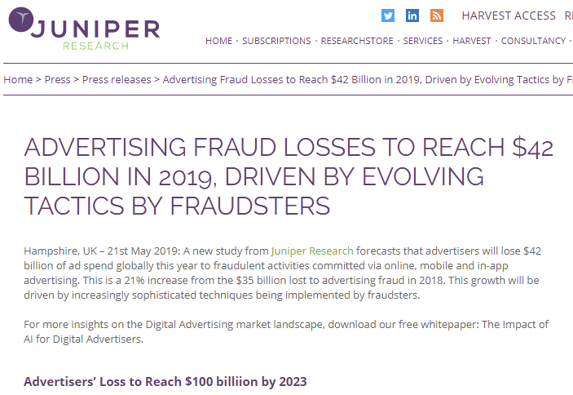
Problems of AD World
https://www.juniperresearch.com/press/press-releases/advertising-fraud-losses-to-reach-42-billion
Notes:
According to Juniper Research – one of the biggest digital market research specialist
They have estimated approx. 42$ billion loss till the end of 2019

Slide 7

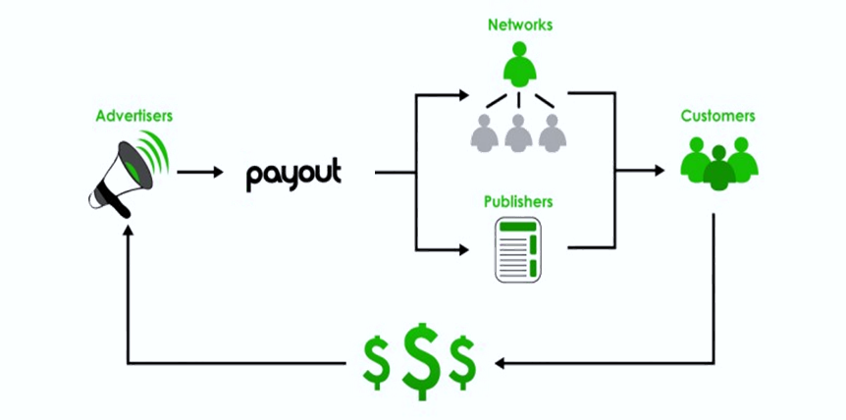
Introduction
CLICK FRAUD
black-hat technique of falsely inflating the number of clicks on a pay-per-click ad.
WHY
Generate Revenue and profit for themselves
Hurt a competitor by depleting their ad budget and improving their own ad position.
Weaken companies by driving up their marketing cost or increase cost of acquisition
https://bigpayout.com/affiliate-network/advertisers/
Notes:
Main Coordinator is the adnetwork/commissioner acting as broker
Advertisers plan a budget , and provide adnetwork/commissioner with advertisements and agrees to pay on a commission for every customer action driven to their site
A content publisher contracts with adnetwork/commissioner to display ads on their app/websites and gets commission based on traffic it diverts to the advertisers ad
MOTIVE & QUESTION
Dishonest publishers generate illegitimate clicks on their site know as click fraud
To generate revenue for themselves
Hurt advertisers competitors
Weaken companies of budget
Given historical patterns (fraud and normal) in some time period . Detect fraud publishers in future time period
Reliable click fraud detection system is needed to help adnetworks/commissioners proactively prevent click fraud and assure advertisers that their money is well spent

Slide 8
Previous Work
Dataset & Preprocessing
Algorithms
Evaluation
Hellinger Distance Decision Tree
Bagging & Boosting Decision Tree
Clustering Using K-Means
Clustering Using Splay Tree Algorithm
Dempster Shafer evidence theory
DATASET :
TalkingData
Avazu
Buzzfeed
Accuracy
ROC-AUC
PREPROCESSING :
Principal Component Analysis (PCA)
Recursive Feature Elimination (RFE)
SMOTE
Notes:
Directly available dataset on kaggle
Problem with dataset is click traffic if its converted or not
PCA on some dataset
RFE
SMOTE to handle imbalance in dataset
ALGORITHMS
Hellinger distance decision tree – works beter with imbalanced data

Slide 9
Dataset Description
Source : LARC SMU-CMU Singapore Management University provided by BuzzCity
R. J. Oentaryo, E.-P. Lim, M. Finegold, D. Lo, F.-D. Zhu, C. Phua, E.-Y. Cheu, G.-E. Yap, K. Sim, M. N. Nguyen, K. Perera, B. Neupane, M. Faisal, Z.-Y. Aung, W. L. Woon, W. Chen, D. Patel, and D. Berrar, "Detecting click fraud in online advertising: A data mining approach," Journal of Machine Learning Research, vol. 15, pp. 99-140, 2014.
Notes:
Acquired from university
Labelled dataset
Inhouse developed mechanism to identify fraud publishers

Slide 10
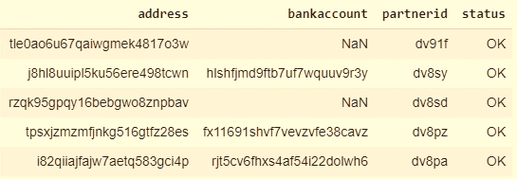
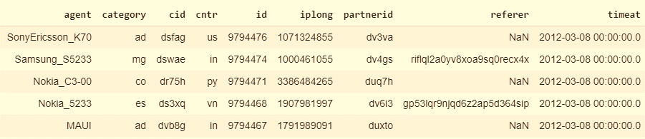
Dataset Snapshot
Notes:
2 categories – publishers database & click traffic database
Users mobile device
Category – publishers channel type
Cntry – users country
cid – campaign id
Ip – user device ip
Partner id – publisher id
Referer – url where the ad banner is clicked

Slide 11
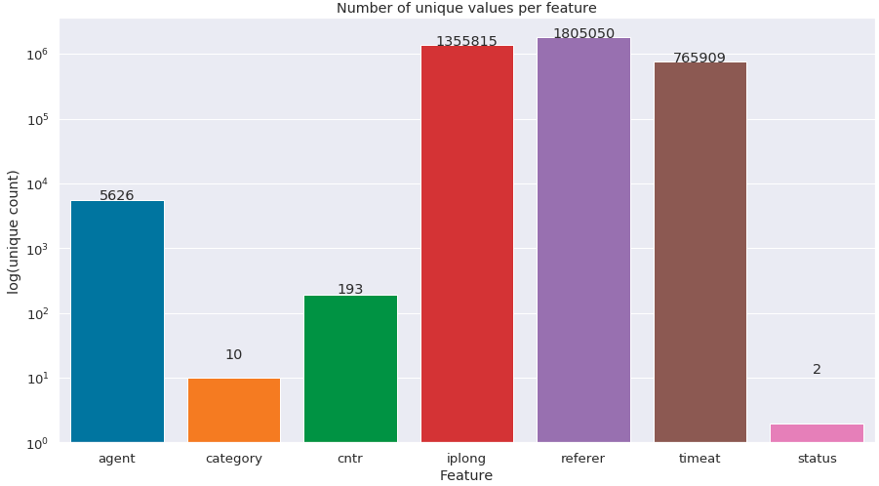
Understanding Dataset
Size : 69,38,523 ie 7 Million
Fraud Count – 4,44,439
Ok Count – 64,94,084
Notes:
Initially dataset was huge with 3 status variables
Removed irrelevant id columns
Null records were cleaned
NOTE : complete dataset is categorical in nature

Slide 12
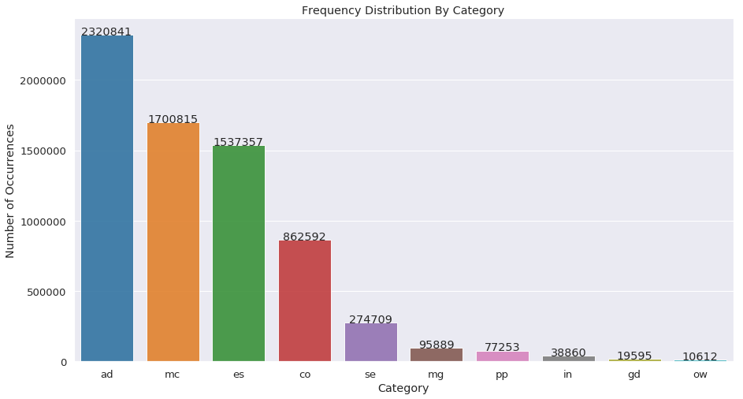
Understanding Dataset
Distribution of Categories for Mobile Data
Top 5 Categories which attract clicks
Adult Sites
Mobile Content
Entertainment & Lifestyles
Community
Search Portal Services
Notes:
To understand dataset better I plotted the distribution of categories in my dataset
Top 5 Publishers categories who tie up with commissioner for funds

Slide 13
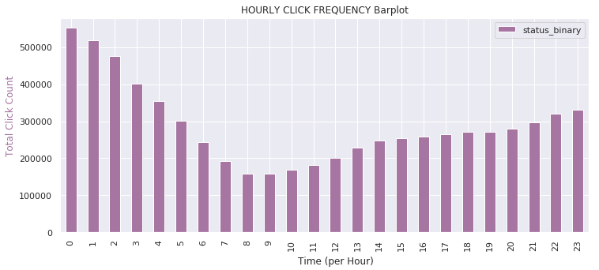
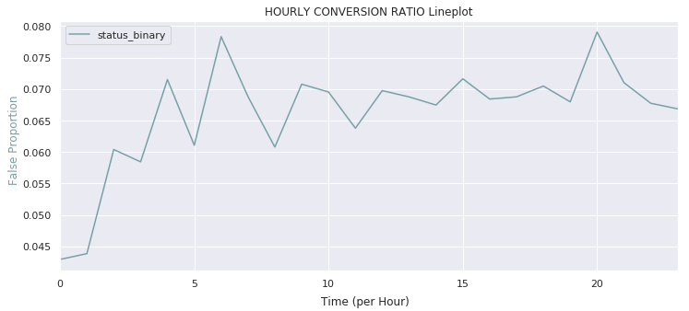
Analytics
Count of clicks increases after 8 am till midnight and then falls
False Count Proportion to the total count received per hour
Notes:
Extarcted time component from timeat column to identify if any patterns exist
Proportion of click fraud by hr

Slide 14
Feature Extraction
Curse of Dimensionality
One Hot Encoding
Encoding Categorical Features [Online]. Available : https://towardsdatascience.com/encoding-categorical-features-21a2651a065c
The Curse of Dimensionality [Online]. Available : https://towardsdatascience.com/the-curse-of-dimensionality-50dc6e49aa1e
Notes:
Most ml model works on numerical data
Encode categorical features
Huge sparce matrix
Slowness in modelling
+ runtime crashes (technical limitations)

Slide 15
Feature Extraction
Sr. No. | Type Of Features | Features Extracted
1 | Time Features : | click_month
 |  | click_day
 |  | click_hour
 |  | click_min
 |  | click_sec
2 | Count Features : | clicks_by_ip
 |  | clicks_by_cntr
 |  | clicks_by_referer
 |  | clicks_by_category
 |  | clicks_by_agent
3 | Count feature By time : | clicks_per_minute
 |  | clicks_per_hour
4 | Count feature By Grouping : | ip_ref_cat_per_min
 |  | ip_ref_cat_per_hr
 |  | ip_cat_per_min
 |  | ip_cat_per_hr
 |  | ip_min_count
 |  | agent_ip_count
 |  | agent_cntr_count
5 | Avg feature By Grouping : | ip_min_avg
 |  | ip_ref_cat_min_avg
 |  | ip_cat_min_avg
Agent
Category
Country
Ip
Referer
Timeat
Notes:
Extracted time components
Count features of each column – this is a unique label encoder mechanism which works for categorical data with lots of unique values
Burst clicks I extracted counts per min / per hr
Few more features to identify relationship between columns so grouped by and calculated count per hr per min and also mean features

Slide 16
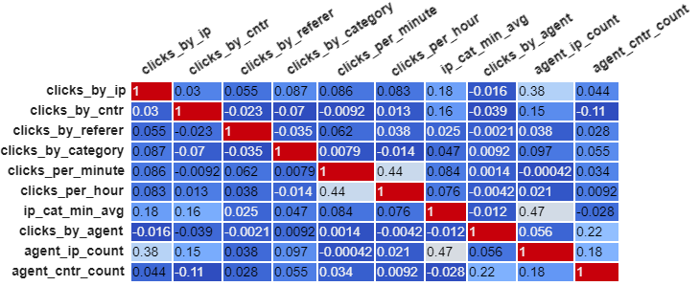
Pre Processing
Recursive Feature Elimination on Decision Tree
UnderSampling after train test split
Scaling : Min-Max
Scaler between 0-1
Correlation Matrix
Notes:
Multiple feature extraction added collinearity to dataset
Thus used RFE to identify top 10 impacting features
Undersampling due to technical limitations
Some algorithms take in magnitude of features thus to standardize the numerical variables I have used min max scaler
It preserves the original normal distribution of data

Slide 17
Algorithms
Logistic Regression
Base Model
Simple Classification Model
Fast Computation
CatBoost
Gradient Boosting on Decision Trees
Works directly on Categorical Data without encoding
Boosting - weak learners are tweaked
Flowchart-like tree structure
Easy to understand and interpret
ADA Boost with Decision Tree Classifier
Bagging Ensemble Learning
Works on categorical & continuous data
Not sensitive to overfitting
Provides feature importance
Random Forest Classifier
Notes:
Base model logistic

Slide 18
Evaluation
Algorithm | Recall | Precision | Accuracy | AUC-ROC
Random Forest | 94 | 54 | 94.44 | 94.14
CatBoost | 88 | 57 | 95.04 | 91.84
ADA Boost + Decision Tree | 92 | 36 | 89.22 | 90.64
Logistic Regression | 65 | 12 | 66.67 | 65.95
Notes:
Precision – overall correctness of the model
Identifying fraud publisher holds more importance than normal onces
Thus recall and roc value I considered to be more relevant
Logistic Regression – works better when data point are independent
Decision trees works when there is pattern in dataset

Slide 19
Conclusion & Future Work
Top Impacting Features - IP, Category, Referrer
Sampling is important due to Bias in Data
Feature Extraction and Selection Increased Accuracy
Decision Trees works best for Fraud Detection
More Parameter Tuning
Model Combination and Ensemble Approach

Slide 20
THANK YOU
Notes:
Photo by rawpixel on Unsplash

